Slide 1
JOURNAL WATCH
vaccination

Slide 2
JOURNALWATCH
تهیه کنندگان: بهجت سادات وهاب زاده
زیر نظر اساتید محترم: جناب آقای دکترمنصوریان ،سرکار خانم کاملی
استاد راهنما: سرکار خانم کاملی

Slide 3
نشریه : آموزشی و سلامت جامعه
صاحب امتیاز : دانشگاه علوم پزشکی همدان
ناشر : دانشگاه علوم پزشکی همدان
وضعیت رتبه : علمی – پژوهشی
زبان نشریه : فارسی – انگلیسی : تاریخ تصویب: 1396
دوره انتشار : فصلنامه

Slide 4
نشریه :آموزش و سلامت جامعه
دسته بندی موضوع کلی :آموزشی (آموزش بهداشت و ارتقاء سلامت)
موضوع اختصاصی : رفتار های مرتبط با سبک زندگی سالم
مدیر مسئول : سید محمد مهدی هزاره ای
سردبیر :سعید بشیریان
مشاوره آماری : مریم فرهادیان
مدیر اجرایی : دکتر مجید براتی
نشانی : همدان – خیابان شهید فهمیده – معاونت تحقیقات و فناوری اداره توسعه و هماهنگی مجلات علمی

Slide 5
پایگاه نمایه کننده :
استوپرس scopus از آغاز سال 2020 شروع شده است پایگاه اطلاعات علمی جهاد دانشگاهی (SID )
پایگاه استناد علوم جهان اسلام (ISC )
بانک اطلاعات نشریات کشور (Magiran )
Seiencclibrary index embase – Googlr scholar

Slide 6
نشریه:آموزش و سلامت جامعه
اهداف:
اهداف و زمینه ها : مجله آموزشی و سلامت جامعه است وابسته به دانشگاه علوم پزشکی و خدمات بهداشت درمانی همدان است هدف این مجله ارتقاء دانش علوم پزشکی با توجه ه زیر ساخت های موجود آموزشی و پژوهشی دانشگاه در زمینه های آموزش بهداشت و ارتقاء سلامت در جامعه است این نشریه از مطالعات مداخله ای که در جهت پیشگیری و کنترل بیماریها واگیر و غیر واگیر انجام می گردد استقبال می کند . همچنین ان مجله مطالعات تحلیلی حوزه رفتار های مرتبط سبک زندگی سالم منتشر می کند . دامنه مطالب موردنظردر این بخش شامل است .

Slide 7
.سوادسلامت – رفتاری ها تغذیه ای – فعالیت های فیزیکی – رفتار ای اعتیاد آور – سلامت جنسی – خود مراقبتی بیماری های مزمن – سلامت روان – سلامت معنوی – سلامت دهان و دندان –تعیین کننده های اجتماعی سلامت – پیشگیری از آسیب ها- کیفیت زندگی – پیشگیری از سرطانها.
لازم به ذکر است مقالات .صرفاتوصیفی که با استفاده از نظام ثبت اطلاعاتی و بدون تحلیل کاربردی مناسب ارائه شوند در اولویت بررسی و چاپ قرار می گیرند.
توجه : بنابر تصمیم اعضای هیئت تحریریه از ابتدای سال 2021 مجله به زبان انگلیسی منتشر خواهد شد.لذا از ابتدای مرداد 1399 .صرفا مقالات ارسالی به زبان انگلیسی موردبررسی و داور پذیری قرار خواهد گرفت .
عضویت cope ( Committeeon publicatiethics )
(کمیته اخلاق نشر )
این مجله عضو کمیته بین المللی اخلاق در انتشار و متعهد به رعایت اصول آن است.

Slide 8
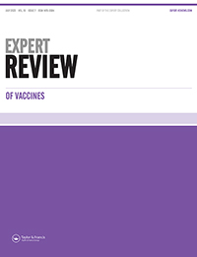
Journal Expert Review of Vaccines
Journal Expert Review of Vaccines
. Journal information
Print ISSN: 1476-0584 Online ISSN: 1744-8395
12 issues per year
H hndex=81
Coverage=2002-2020

Slide 9
Expert Review of Vaccines is included in the following abstracting and indexing services:
Journal Expert Review of Vaccines
Biobase; Chemical Abstracts; Current Contents®/Clinical Medicine; EMBASE/Excerpta Medica; Journal Citation Reports/Science Edition®; MEDLINE/Index Medicus; Science Citation Index Expanded™ (SciSearch®); Scopus.
2019 Impact Factor: 4.362
Ranking: 51/158 Immunology
© 2020 Journal Citation Reports® (Clarivate Analytics, 2020)

Slide 10
Journal Expert Review of Vaccines
Taylor & Francis make every effort to ensure the accuracy of all the information (the "Content") contained in our publications. However, Taylor & Francis, our agents, and our licensors make no representations or warranties whatsoever as to the accuracy, completeness, or suitability for any purpose of the Content. Any opinions and views expressed in this publication are the opinions and views of the authors, and are not the views of or endorsed by Taylor & Francis. The accuracy of the Content should not be relied upon and should be independently verified with primary sources of information. Taylor & Francis shall not be liable for any losses, actions, claims, proceedings, demands, costs, expenses, damages, and other liabilities whatsoever or howsoever caused arising directly or indirectly in connection with, in relation to, or arising out of the use of the Content. Terms & Conditions of access and use can be found at http://www.tandfon
Aims and scope
2019 Impact Factor: 4.362
Ranking: 51/155 Immunology
© 2020 Journal Citation Reports® (Clarivate Analytics, 2020)

Slide 11
Journal Expert Review of Vaccines
Expert Review of Vaccines (1476-0584; 1744-8395) is a MEDLINE-indexed, international journal publishing rigorously peer-reviewed research in the development, application, and clinical effectiveness of new vaccines.
Each article is structured to incorporate the author’s own expert opinion on the impact of the topic on research and clinical practice and the scope for future development.
The journal features vaccine technology, vaccine adjuvants, prophylactic vaccines, therapeutic vaccines, AIDS vaccines and vaccines for defence against bioterrorism.
The vaccine field has been transformed by recent technological advances, but there remain many challenges in the delivery of cost-effective, safe vaccines. Expert Review of Vaccines facilitates decision making to drive forward this exciting field.
Comprehensive coverage in each review is complemented by the unique Expert Collection format and includes the following sections:
Expert Opinion – a personal view of the data presented in the article, a discussion on the developments that are likely to be important in the future, and the avenues of research likely to become exciting as further studies yield more detailed results;

Slide 12
Journal Expert Review of Vaccines
Article Highlights – an executive summary of the author’s most critical points.
All manuscripts submitted to the journal are peer-reviewed in a double-blind fashion, and the journal’s Editorial Advisory Board are responsible for adjudicating decisions where necessary.
Authors can choose to publish gold open access in this journal.
Read the Instructions for Authors for information on how to submit your article. For any pre-submission enquiries, please contact the

Slide 13
Journal Expert Review of Vaccines
Editorial board
Sergio Abrignani, National Institute of Molecular Genetics, Italy
Jon Kim Andrus, Sabin Vaccine Institute, Washington DC, USA
Vasso Apostolopoulos, Victoria University, Melbourne
Philip M Arlen, Precision Biologics, Washington DC, USA
P Noel Barrett, Baxter BioScience, Austria
Igor Belyakov, University of Michigan, MI, USA

Slide 14
Journal Expert Review of Vaccines
Alexander Bukreyev, University of Texas Medical Branch, TX, USA
Myron Christodoulides, University of Southampton, UK
John Clemens, UCLA Fielding School of Public Health, USA
Angus G Dalgleish, St George's Hospital Medical School, UK
Ronald W Ellis, FutuRx Ltd, Israel
Gregory Glenn, Novavax, MD, USA
Michael Good, Griffith University, Queensland, Australia
Stephen Hoffman, Sanaria Inc., MD, USA
JU Igietseme, CDC Atlanta, GA, USA

Slide 15
Journal Expert Review of Vaccines
Odile Launay, Paris Descartes University, Cochin Hospital, Paris, France
Camille Locht, Institut Pasteur de Lille, France
Alex Loukas, James Cook University, Australia
Umesh Parashar, Centers for Disease Control and Prevention, Atlanta, Georgia, USA
Andrew J Pollard, University of Oxford, UK
Shabir Madhi, National Institute for Communicable Diseases, Johannesburg, South Africa
Jan Poolman, Johnson & Johnson, Leiden, Netherlands
Punnee Pitisuttithum, Mahidol University, Bangkok, Thailand
Rino Rappuoli, Novartis Vaccines, Italy
Steven G Reed, Infectious Disease Research Institute, WA, USA
Gus Rimmelzwaan, Erasmus Medical Centre, Rotterdam, The Netherlands
Larisa Rudenko, Institute of Experimental Medicine, Saint Petersburg, Russia
Suryaprakash Sambhara, CDC Atlanta, GA, USA

Slide 16
Journal Expert Review of Vaccines
Alessandro Sette, La Jolla Institute for Allergy and Immunology, CA, USA
Leonard A. Smith, US Army Medical Research Institute of Infectious Diseases, MD, USA
De-chu Christopher Tang, International Vaccine Institute, Seoul, Korea
Ralph A Tripp, The University of Georgia, GA, USA
Takafumi Tsuboi, Ehime University, Ehime, Japan
Jeffrey Ulmer, GSK Vaccines, MD, USA
David B Weiner, University of Pennsylvania School of Medicine, PA, USA
Annelies Wilder-Smith, Lee Kong Chian School of Medicine, Singapore
Feng-Cai Zhu, Jiangsu Provincial Center for Disease Control and Prevention, China

Slide 17
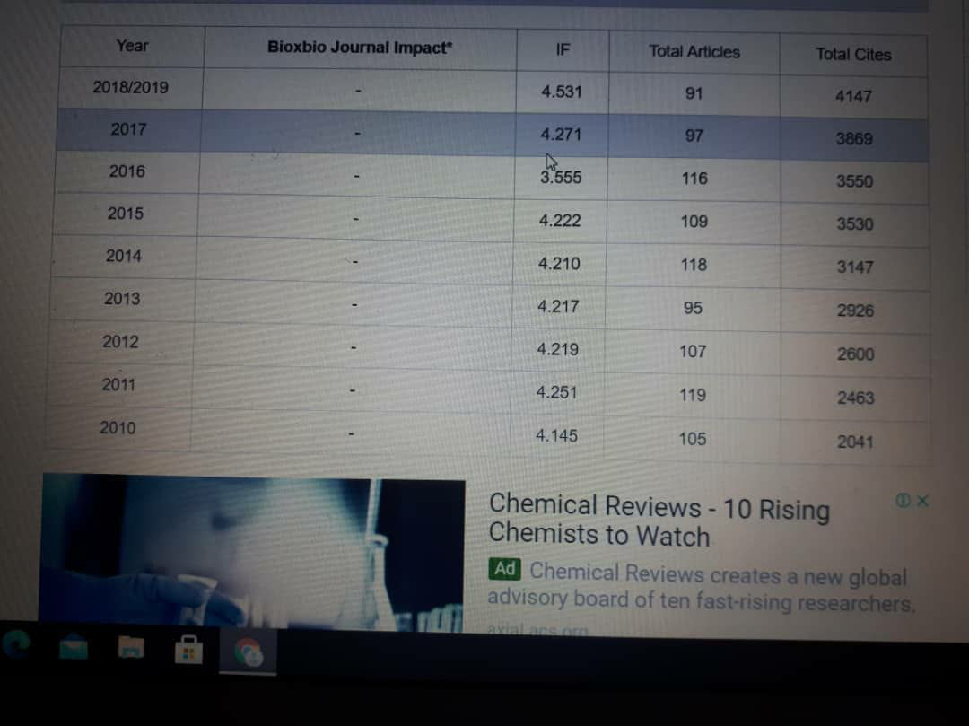

Slide 18
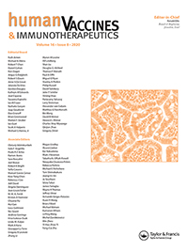
Human Vaccines & Immunotherapeutics
Print ISSN: 2164-5515 Online ISSN: 2164-554X
12 issues per year
Human Vaccines & Immunotherapeautics is abstracted/indexed in:
Adis International Ltd. - Reactions Weekly (Online)
EBSCOhost - Biological Abstracts (Online)
Elsevier BV - EMBASE - Scopus
National Library of Medicine - PubMed/MEDLINE
Thomson Reuters - Biological Abstracts (Online) - BIOSIS Previews - Biotechnology Citation Index (Online) - Science Citation Index Expanded - Web of Science

Slide 19
Human Vaccines & Immunotherapeutics
Taylor & Francis make every effort to ensure the accuracy of all the information (the "Content") contained in our publications. However, Taylor & Francis, our agents, and our licensors make no representations or warranties whatsoever as to the accuracy, completeness, or suitability for any purpose of the Content. Any opinions and views expressed in this publication are the opinions and views of the authors, and are not the views of or endorsed by Taylor & Francis. The accuracy of the Content should not be relied upon and should be independently verified with primary sources of information. Taylor & Francis shall not be liable for any losses, actions, claims, proceedings, demands, costs, expenses, damages, and other liabilities whatsoever or howsoever caused arising directly or indirectly in connection with, in relation to, or arising out of the use of the Content. Terms & Conditions of access and use can be found at http://www.tandfonline.com/page/terms-and-conditions .

Slide 20
Human Vaccines & Immunotherapeutics
Publication history
Currently known as:
Human Vaccines & Immunotherapeutics (2012 - current)
Formerly known as
Human Vaccines (2005 - 2011)
Aims and scope
Human Vaccines & Immunotherapeutics publishes international research into vaccinology and immunotherapy, including novel and experimental vaccine exploration. Human Vaccines & Immunotherapeutics is sponsored by the International Society for Vaccines (ISV).
The aim of Human Vaccines & Immunotherapeutics is to provide a platform to present and discuss developments in vaccinology and immunotherapy. The journal covers the following topics:

Slide 21
Human Vaccines & Immunotherapeutics
Research and development of novel vaccines and immunotherapeutics
Experimental vaccines and novel approaches in vaccination and immunotherapy
Vaccines and immunotherapeutics for treating non-infectious diseases, e.g., cancer
Preclinical studies and clinical trials
Licensed products and their use in the field
Impact of licensed vaccines and Immunotherapeutics on disease
Safety and perceptions of licensed vaccines
Prevention and treatment in the developing world
Epidemiology and pharmaco-economics
The journal publishes original research articles, short reports, case reports, reviews and commentaries.

Slide 22
Human Vaccines & Immunotherapeutics
Human Vaccines & Immunotherapeutics operates a single-blind peer review policy. Authors can choose to publish gold open access in this journal.
Read the Instructions for Human Vaccines And Immunotherapeutics
List of issues
Latest aesrticl
Volume 16 2020
Volume 15 2019
Volume 14 2018
Volume 13 2017
Volume 12 2016
Volume 11 2015
Volume 10 2014
Volume 9 2013
Volume 8 2012
Volume 7 2011
Volume 6 2010
Volume 5 2009
Volume 4 2008
Volume 3 2007
Volume 2 2006
Volume 1 2005ctor Trend 2Year

